Slide 1

Capstone Project – I [7CS1999/7IT 1999]
Alliance School of Advanced Computing
Project Title: AgroPQ: An AI-Powered Crop Disease Detection and Agrochemical Recommendation Framework with Post-Quantum Secure Cloud Communication
Batch : 2023 - 2027
Review No : 1
Batch No : ASAC-CP-009
Presented by
Student Name Branch Reg No
Chalini M CSE-AIML 2023BCSE07AED440
Spandana Basava Kulal CSE-AIML 2023BCSE07AED441
Name of the Mentor: Dr. Qawsar Gulzar
Date of Review : 4-08-2026

Slide 2

Outline
Project Overview
Literature Review
Research Gap
Requirements Analysis
Proposed Methodology
Project work plan and timeline
References

Slide 3
I. Project Overview
Problem Context – Farmers may struggle to identify crop diseases early and select the appropriate agrochemical treatment. Traditional diagnosis can be time-consuming and dependent on expert knowledge.
Motivation – To develop an AI-based system that can detect crop diseases from plant images and provide suitable agrochemical recommendations.
Significance – Helps in early disease detection, reduces unnecessary agrochemical usage, supports better farming decisions, and protects agricultural data through secure communication.
Application Domain – Smart Agriculture / Precision Agriculture / AI in Agriculture / Cloud Security
Target Users – Farmers, agricultural consultants, agronomists, agricultural researchers, and farm-management organizations.

Slide 4
II. Literature Review
Review of Relevant Research
1. Plant Disease Detection and Classification by Deep Learning—A Review
Authors: Lili Li, Shujuan Zhang, Bin Wang
Core Contribution: Reviews deep learning methods used for plant disease detection and classification.
Limitation: Performance can be affected by limited datasets and differences between laboratory and real-field images.
Advantages: Deep learning can automatically extract disease features and effectively classify plant diseases.
2. Image-based Crop Disease Detection Using Machine Learning (2025)
Authors: Aria Dolatabadian, Ting Xiang Neik, Monica F. Danilevicz, Shriprabha R. Upadhyaya, Jacqueline Batley, David Edwards
Core Contribution: Reviews machine-learning and imaging techniques used for crop disease detection across different crops and environmental conditions.
Limitation: Differences in imaging conditions, environmental factors, datasets, and real-field conditions can affect detection performance.
Advantages: Provides a comprehensive overview of ML/AI methods, imaging technologies, contextual data, and real-time crop disease detection approaches

Slide 5
II. Literature Review
3. AI-Driven Smart Agriculture: An Integrated Approach for Soil Analysis, Irrigation, and Crop-Fertilizer Recommendations (2025)
Authors: Ayesha Khaliq, Atif Khan, Salman Jan, Muhammad Umair, Asad Gulshair, Ahmad Ali, Usman Ali Shah
Core Contribution: Developed an AI + IoT-based system integrating soil analysis, irrigation advice, crop recommendation, and fertilizer recommendation.
Limitation: The authors identify the need to improve model generalization across different geographical regions and develop real-time adaptive control.
Advantages: Uses TabNet, SwiFT, XAI and IoT sensors; achieved 99.3% accuracy for fertilizer recommendation and provides explainable recommendations
4. Internet of Things (IoT) Assisted Context Aware Fertilizer Recommendation
Authors: Arfat Ahmad Khan, Muhammad Faheem, Rab Nawaz Bashir, Chitaphong Wechtaisong, Muhammad Zahid Abbas
Core Contribution: Developed an IoT-assisted, context-aware system for recommending suitable fertilizers based on agricultural conditions.
Limitation: The system depends on the availability and accuracy of IoT/sensor data and contextual information.
Advantages: Combines IoT and intelligent recommendation, enabling more context-aware and data-driven fertilizer recommendations.

Slide 6
II. Literature Review
5. AI-Driven Smart Agriculture: An Integrated Approach for Soil Analysis, Irrigation, and Crop-Fertilizer Recommendations (2025)
Authors: Ayesha Khaliq, Atif Khan, Salman Jan, Muhammad Umair, Asad Gulshair, Ahmad Ali, Usman Ali Shah
Core Contribution: Proposes an AI-driven smart agriculture system integrating soil analysis, irrigation, crop recommendation, and fertilizer recommendation.
Limitation: The system may require reliable soil and environmental data for accurate recommendations.
Advantages: Provides an integrated and intelligent approach for crop and fertilizer recommendations, making agricultural decision-making more data-driven.
6. Post-Quantum Cryptography (PQC) for IoT-Consumer Electronics Devices Integrated With Deep Learning (2025)
Authors: Ankita Sharma, Shalli Rani
Core Contribution: Integrates Post-Quantum Cryptography (PQC) with IoT devices and deep learning to improve security against quantum-computing threats.
Limitation: PQC can introduce additional computational and communication overhead in resource-constrained IoT devices.
Advantages: Provides quantum-resistant security for IoT devices while combining it with deep-learning-based security mechanisms.

Slide 7
II. Literature Review
7. Post-quantum cryptography-driven security framework for cloud computing (2022)
Authors: Henry Chima Ukwuoma, Gabriel Arome, Aderonke Thompson, Boniface Kayode Alese
Core Contribution: Proposed a post-quantum cryptography (PQC)-driven security framework to protect data in cloud computing environments.
Limitation: PQC algorithms can require higher computational and communication resources compared with traditional cryptographic methods.
Advantages: Provides quantum-resistant security for cloud data and helps protect cloud communication against future quantum-based attacks.
8. IoT-Enabled Secure and Scalable Cloud Architecture for Multi-User Systems: A Hybrid Post-Quantum Cryptographic and Blockchain-Based Approach Toward a Trustworthy Cloud Computing (2023)
Authors: Reyazur Rashid Irshad, Shahid Hussain, Ihtisham Hussain, Jamal Abdul Nasir, Asim Zeb, Khaled M. Alalayah, Ahmed Abdu Alattab, Adil Yousif, Ibrahim M. Alwayle
Core Contribution: Proposes a secure cloud architecture combining IoT, Post-Quantum Cryptography (PQC), and blockchain for protecting cloud-based data.
Limitation: Combining multiple security technologies can increase system complexity and computational overhead.
Advantages: Provides quantum-resistant cloud security, supports IoT environments, and improves data integrity and trust in cloud communication.

Slide 8
II. Literature Review
Key Findings from Literature
AI-Based Disease Detection Advantage: Deep learning and CNN models provide effective automated plant disease detection and classification from leaf images, reducing the need for manual disease identification.
Smart Agrochemical Recommendation Gap: Existing recommendation systems use soil, crop, environmental, and IoT data for fertilizer recommendations, but they depend heavily on data quality and have limited integration with disease detection.
Secure Agriculture Communication Gap: Post-quantum cryptography provides quantum-resistant security for IoT and cloud systems, but existing studies largely focus on security separately rather than integrating PQC with AI-based crop disease detection and agrochemical recommendation.

Slide 9
III. Research Gap
Identified Research Gap – Existing studies mainly focus on disease detection, while disease detection, agrochemical recommendation, and secure cloud communication are rarely integrated into one system.
Technical Limitations – Many existing models are trained on controlled datasets and may have reduced performance on real-field images. Recommendation systems may also depend on limited soil/crop information.
Need for Proposed Work – A system is needed that can provide early disease detection, suitable agrochemical recommendations, and secure transmission of agricultural data.
Proposed Differentiation – Our system combines AI-based disease detection + smart agrochemical recommendation + Explainable AI + Post-Quantum Cryptography (PQC)-based secure cloud communication in a single platform.

Slide 10
IV. Requirements Analysis
Hardware Requirements – Computer/laptop with sufficient RAM and GPU support for training the AI model; cloud server for secure data storage and communication.
Software Requirements – Python, TensorFlow/PyTorch, OpenCV, ML/DL libraries, database, cloud platform, and PQC cryptographic libraries.
Dataset / Resource Requirements – Crop/plant leaf disease image datasets, disease labels, crop and disease information, agrochemical information, and relevant soil/environmental parameters.
Constraints – Limited and imbalanced datasets, real-world image variations, computational requirements for AI models, accuracy of agrochemical recommendations, and PQC communication overhead.

Slide 11
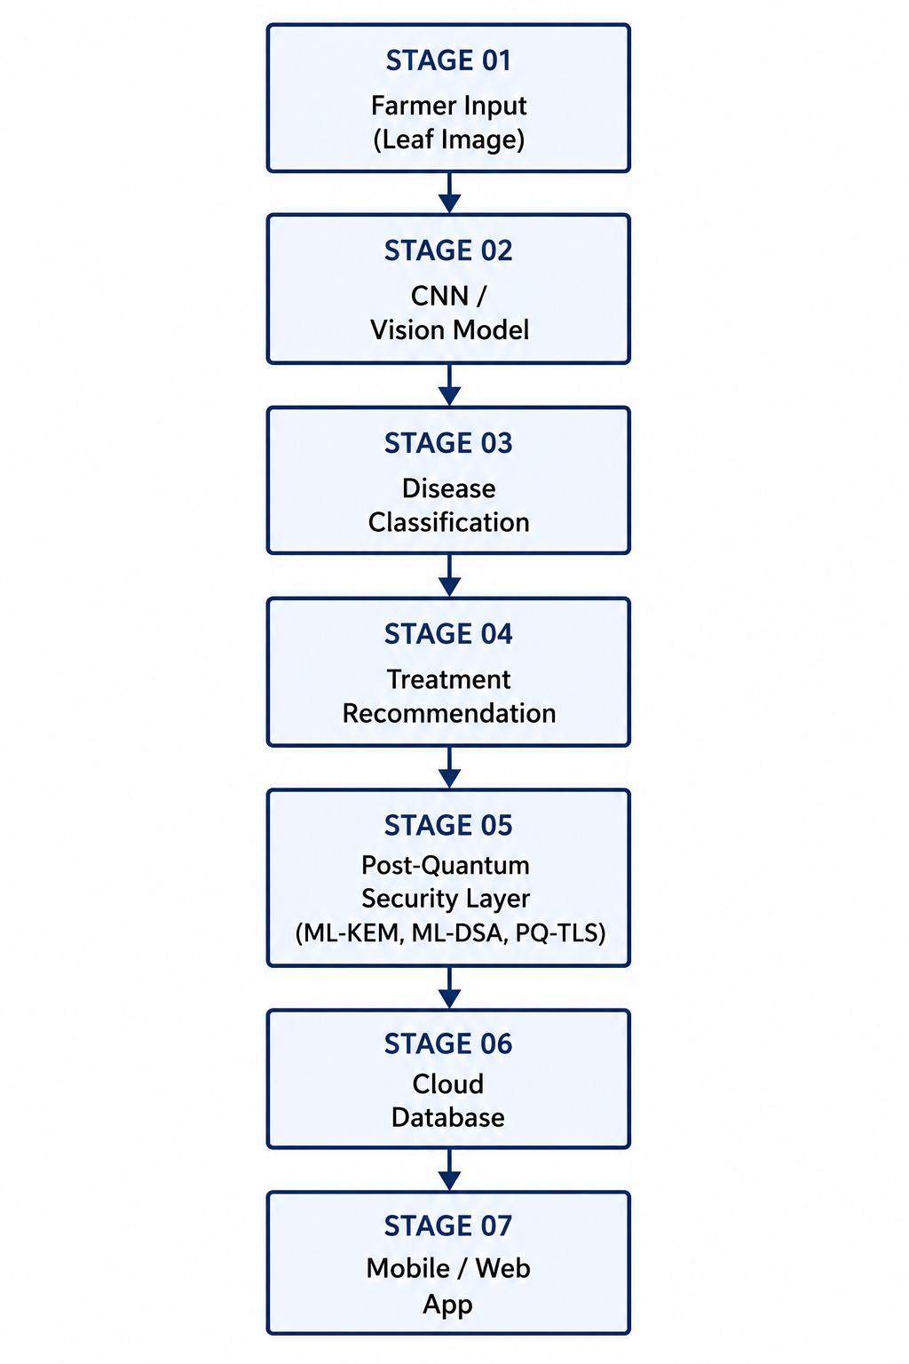
V. Proposed Methodology
Figure 1: Architectural Diagram for the Proposed Framework

Slide 12
V. Proposed Methodology
Methodology Workflow:
Step 1 (Image Input): Farmer uploads a crop/leaf image through the application.
Step 2 (Disease Detection): CNN/Vision model processes the image and identifies the crop disease.
Step 3 (Disease Classification): The system classifies the detected disease and provides the prediction result.
Step 4 (Treatment Recommendation): Based on the disease and relevant crop information, the system recommends suitable agrochemicals/treatment.
Step 5 (Post-Quantum Security): Agricultural data is protected using ML-KEM, ML-DSA, and PQ-TLS before cloud communication.
Step 6 (Cloud Storage): Securely stores relevant disease-detection and recommendation data in the cloud database.
Step 7 (Application Output): Results and recommendations are displayed to the farmer through the mobile/web application.

Slide 13
V. Proposed Methodology
Algorithms & Techniques
Image Processing: Image preprocessing, resizing, normalization, and augmentation.
Disease Detection: CNN / Vision model for crop disease classification.
Recommendation: ML-based agrochemical recommendation using disease, crop, soil, and environmental information.
Explainable AI: SHAP / XAI techniques to explain disease predictions and recommendations.
Post-Quantum Security: ML-KEM, ML-DSA, and PQ-TLS for secure cloud communication.
Module Breakdown
Module 1 (Image & Dataset): Dataset collection, image preprocessing, augmentation, and disease-label preparation.
Module 2 (Disease Detection): CNN/Vision model training and crop disease classification.
Module 3 (Agrochemical Recommendation): Disease-based treatment recommendation using relevant crop, soil, and environmental parameters.
Module 4 (Explainability & Security): XAI-based explanation and PQC-secured cloud communication using ML-KEM, ML-DSA, and PQ-TLS.

Slide 14
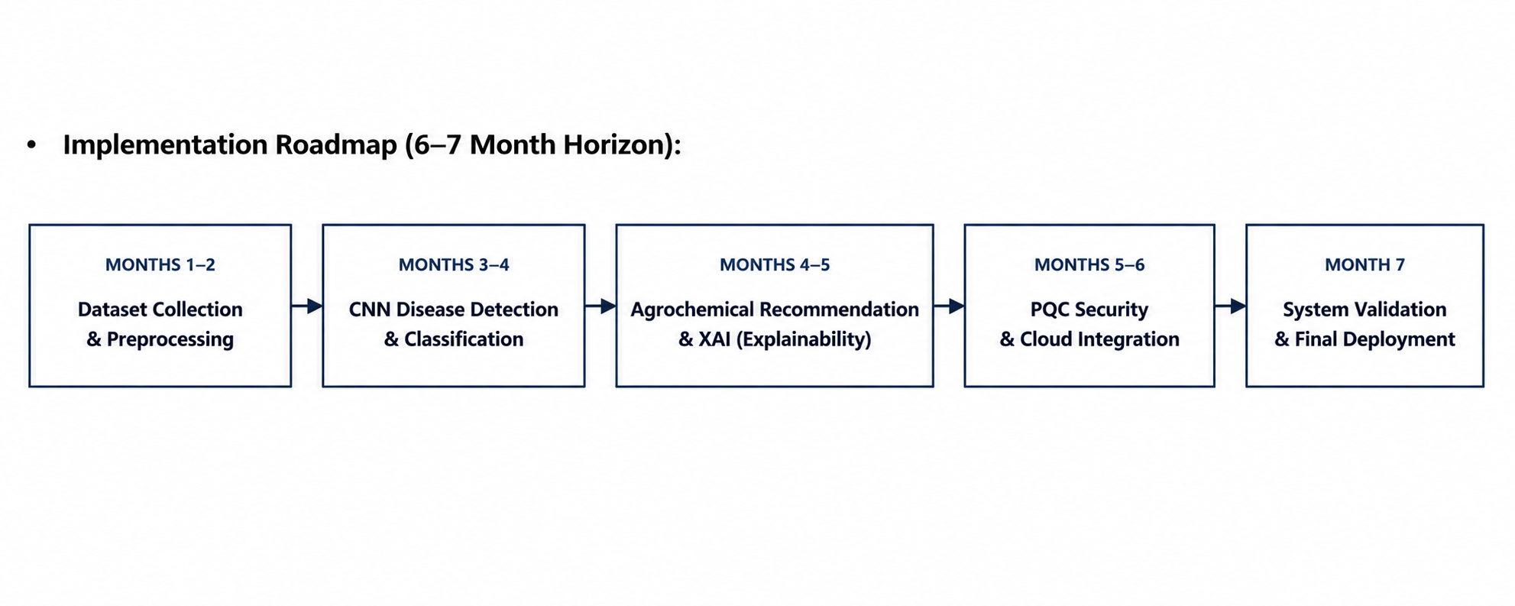
VI. Project work plan and timeline
Technology Stack
1. AI / Deep Learning: Python, PyTorch/TensorFlow, CNN / Vision models for crop disease detection.
2. Machine Learning: Scikit-learn, Pandas, NumPy for agrochemical recommendation and data processing.
3. Explainable AI: SHAP / XAI techniques for explaining disease predictions and recommendations.
4. Post-Quantum Security: ML-KEM, ML-DSA and PQ-TLS for quantum-resistant secure cloud communication.
5. Cloud & Application: Cloud database, REST API, and Mobile/Web application for farmer interaction.
Implementation Roadmap (6–7 Month Horizon):

Slide 15
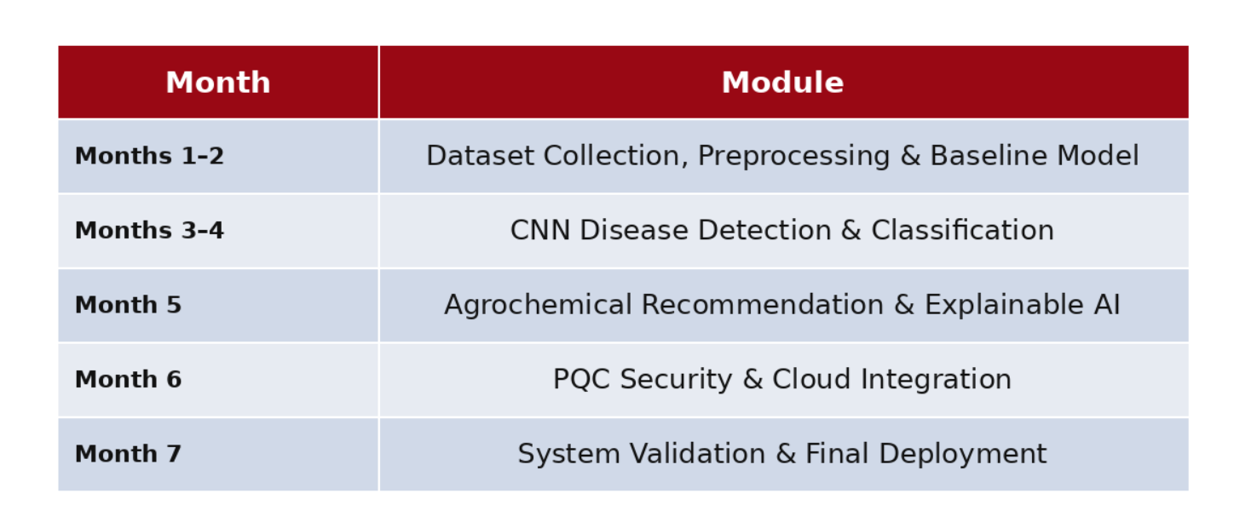
VI. Project work plan and timeline
Module-wise Timeline

Slide 16
VII.References
Research Papers:
Li, L., Zhang, S., & Wang, B. (2021). “Plant Disease Detection and Classification by Deep Learning—A Review,” IEEE Access, vol. 9, pp. 56683–56698.
Dolatabadian, A., Neik, T. X., Danilevicz, M. F., Upadhyaya, S. R., Batley, J., & Edwards, D. (2025). “Image-based Crop Disease Detection Using Machine Learning,” Plant Pathology, vol. 74, no. 1, pp. 18–38.
Khan, A. A., Faheem, M., Bashir, R. N., Wechtaisong, C., & Abbas, M. Z. (2022). “Internet of Things (IoT) Assisted Context Aware Fertilizer Recommendation.”
Khaliq, A., Khan, A., Jan, S., Umair, M., Gulshair, A., Ali, A., & Shah, U. A. (2025). “AI-Driven Smart Agriculture: An Integrated Approach for Soil Analysis, Irrigation, and Crop-Fertilizer Recommendations.”
Sharma, A. A., & Rani, S. (2025). “Post-Quantum Cryptography (PQC) for IoT-Consumer Electronics Devices Integrated With Deep Learning,” IEEE Transactions on Consumer Electronics.
Ukwuoma, H. C., Arome, G., Thompson, A., & Alese, B. K. (2022). “Post-quantum cryptography-driven security framework for cloud computing,” Open Computer Science, vol. 12, no. 1, pp. 142–153.
Natarajan, S., Chakrabarti, P., & Margala, M. (2024). “Robust Diagnosis and Meta Visualizations of Plant Diseases Through Deep Neural Architecture With Explainable AI,” Scientific Reports, vol. 14, Article 13695.
Tanaka, T. S. T., Heuvelink, G. B. M., Mieno, T., & Bullock, D. S. (2024). “Can Machine Learning Models Provide Accurate Fertilizer Recommendations?” Precision Agriculture, vol. 25, no. 4, pp. 1839–1856

Slide 17
VII.References
Datasets and online Resources
S. P. Mohanty, D. P. Hughes and M. Salathé, “Using Deep Learning for Image-Based Plant Disease Detection,” Frontiers in Plant Science, 2016. PlantVillage Dataset — 54,306 healthy and diseased leaf images across 38 categories.
D. Singh et al., “PlantDoc: A Dataset for Visual Plant Disease Detection,” Proc. ACM India Joint International Conference on Data Science and Management of Data (CoDS-COMAD), 2020, pp. 249–253. PlantDoc Dataset — real-world plant disease images useful for testing performance beyond controlled datasets.
Fertilizer Recommendation Dataset, Kaggle, 2025. Online. Available: Kaggle Fertilizer Recommendation Dataset
National Institute of Standards and Technology (NIST), “Post-Quantum Cryptography,” 2024. Online. Available: NIST Post-Quantum Cryptography Resources

Slide 18













Department of Computer Science and Engineering Alliance School of Advanced Computing
THANK YOU
Presented by
ASAC-CP-009
©ASAC – Alliance University, 2026. All rights reserved. Unauthorized reproduction or distribution is prohibited.

